Slide 1
Group F8- Project A
Sierra Acy
Natahlie Beavers
Nalisia Greenleaf

Slide 2
Part 1: ARL Application

Slide 3
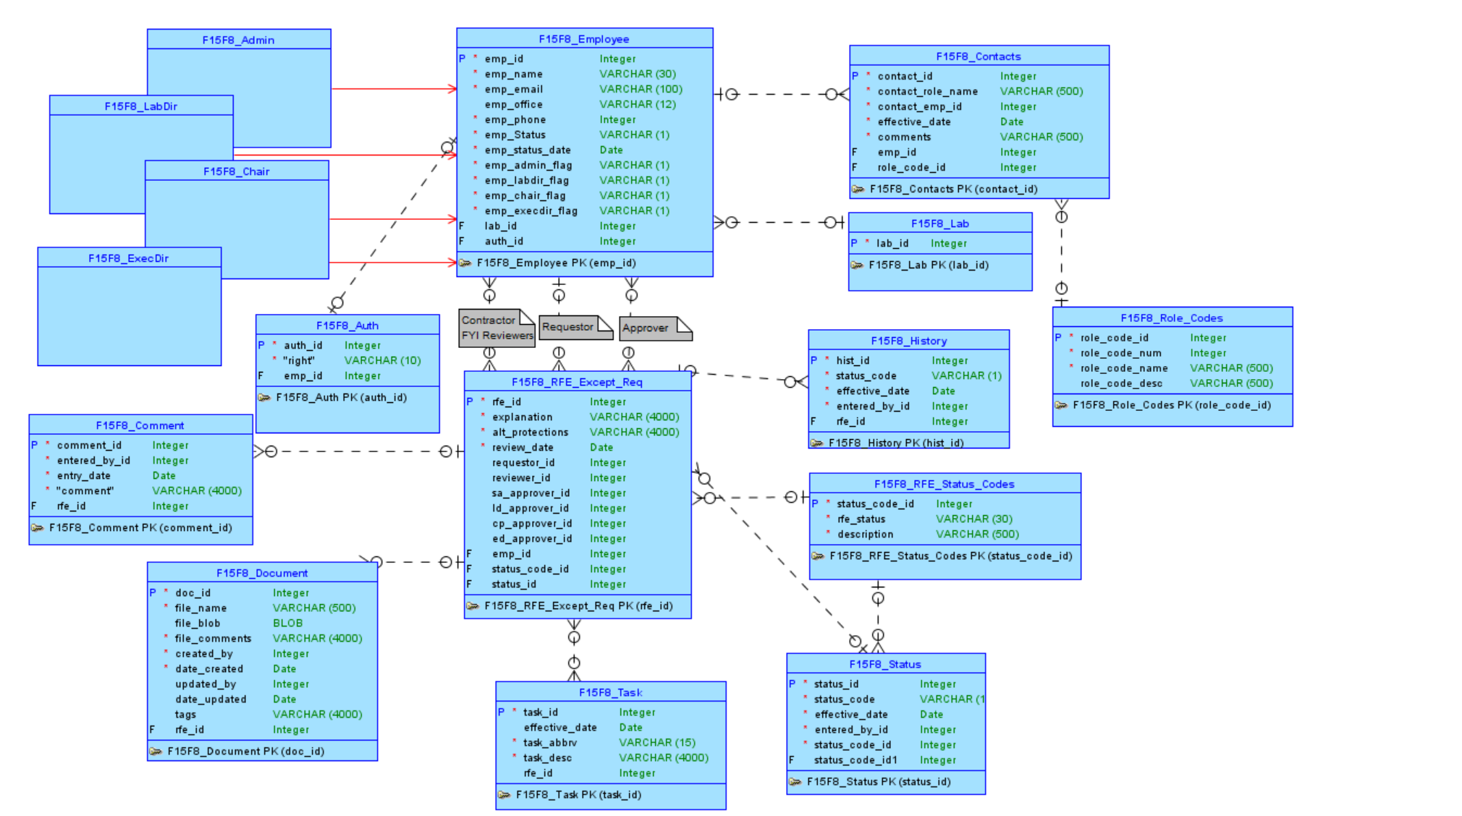
Part 1: Conceptual Model

Slide 4
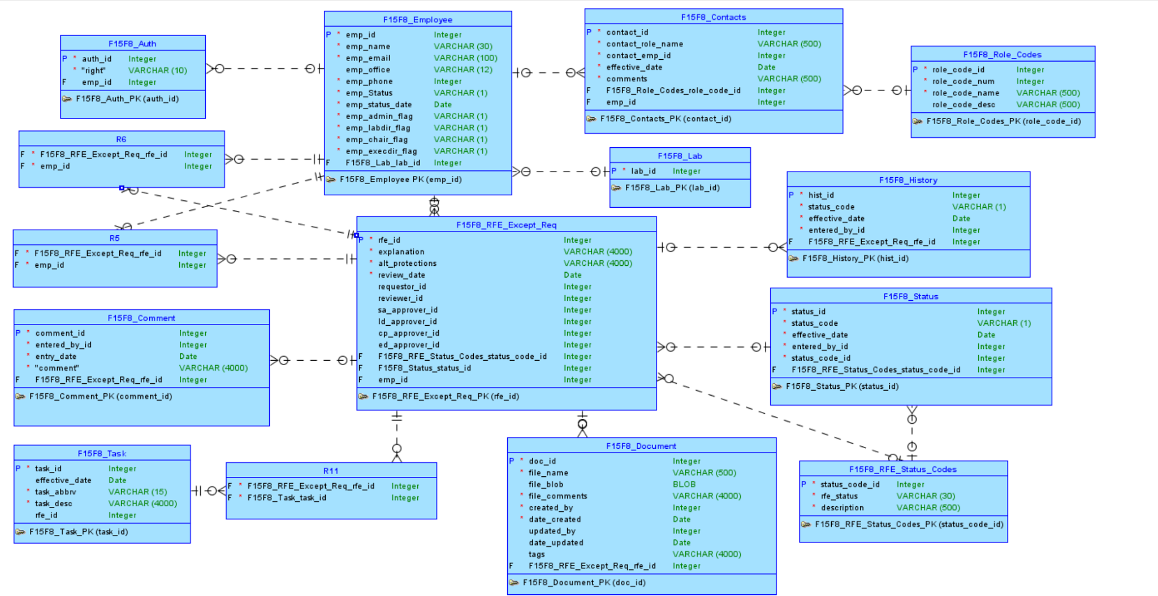

Slide 5
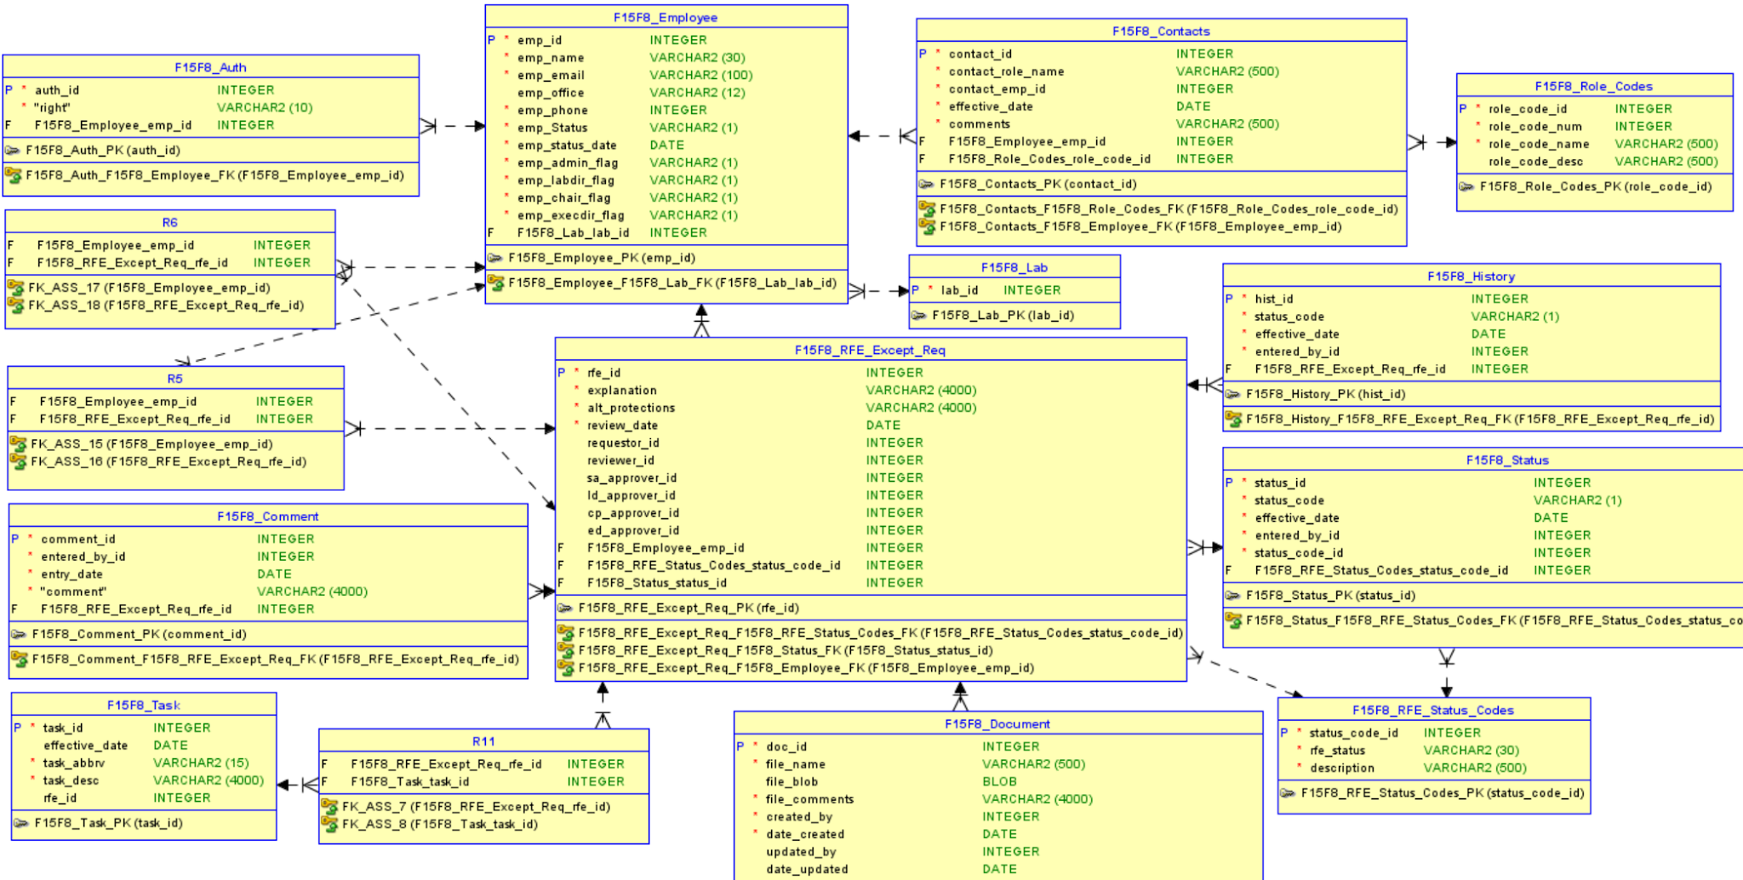

Slide 6
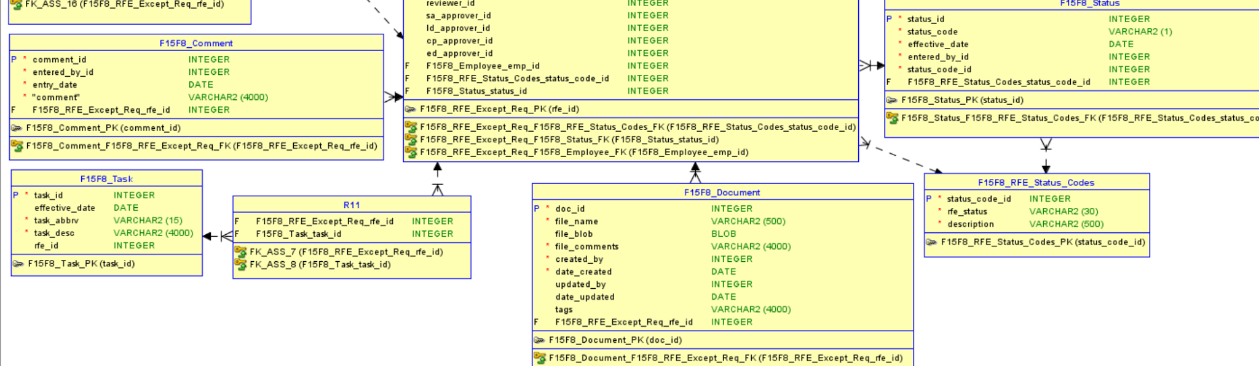

Slide 7
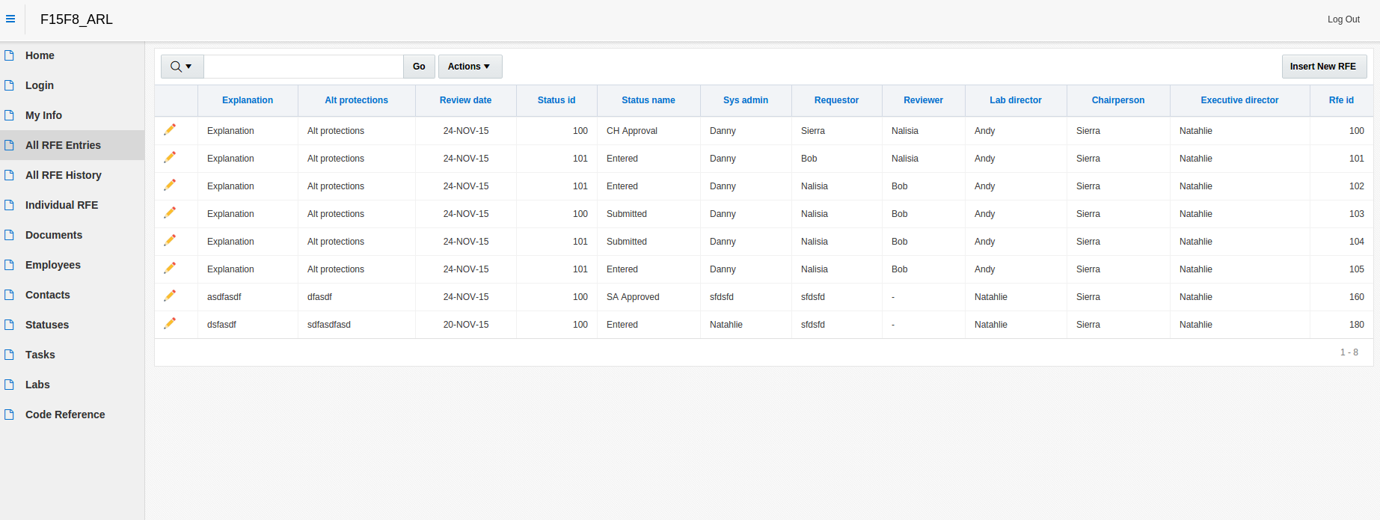

Slide 8
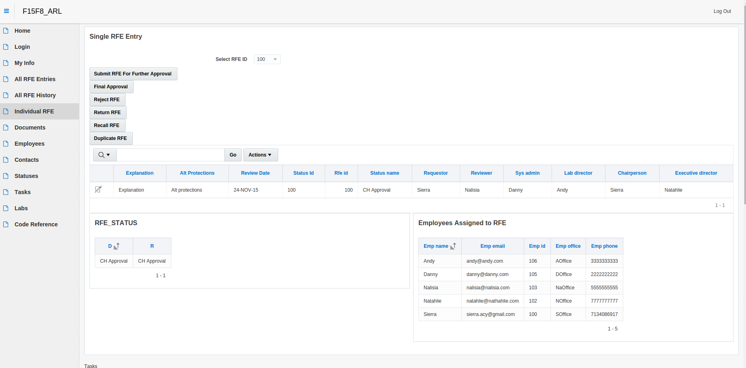

Slide 9
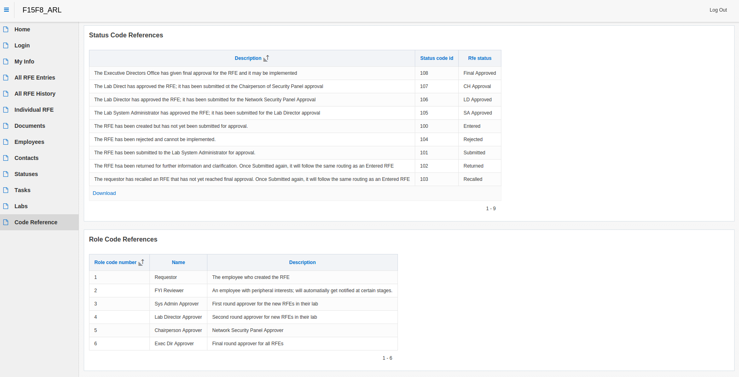

Slide 10
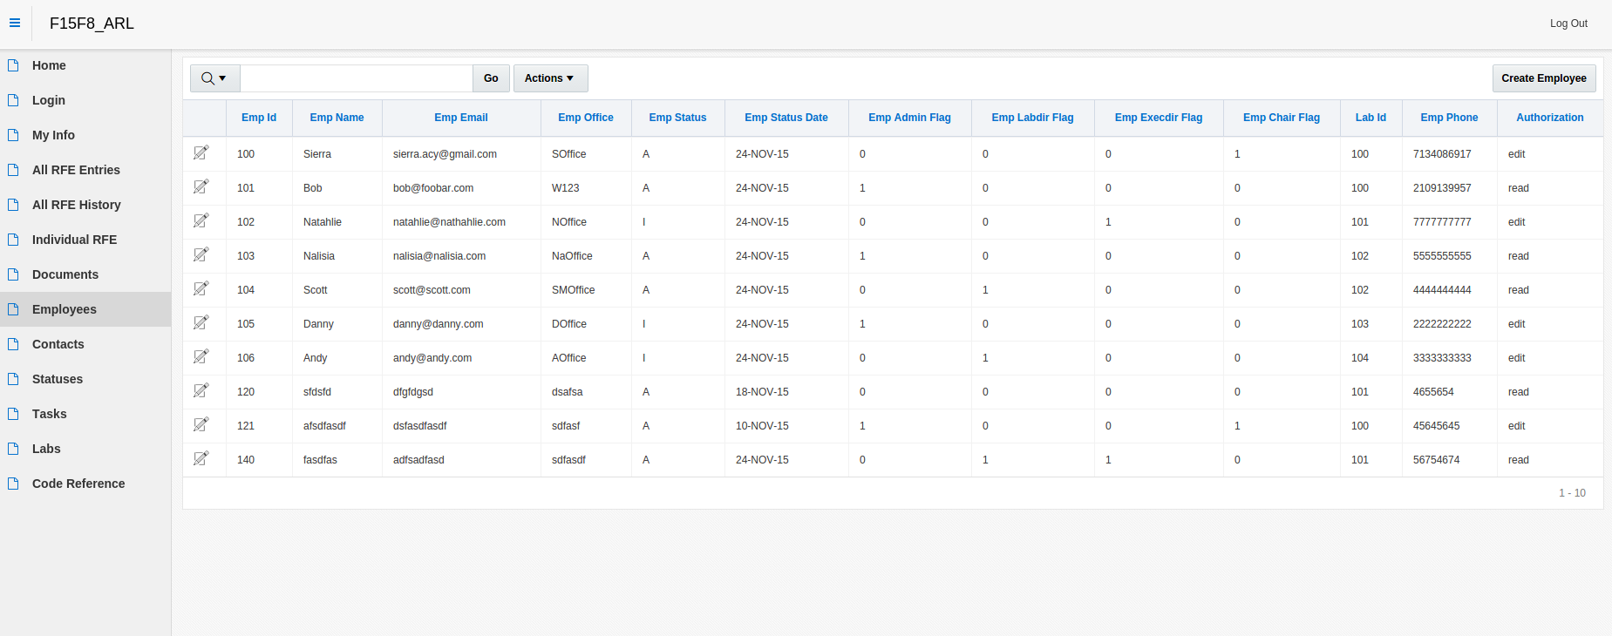

Slide 11
Apex ARL Model
https://apex.oracle.com/pls/apex/f?p=22584:71:7900671850340::NO:::

Slide 12
Part 2: Mobile Application

Slide 13
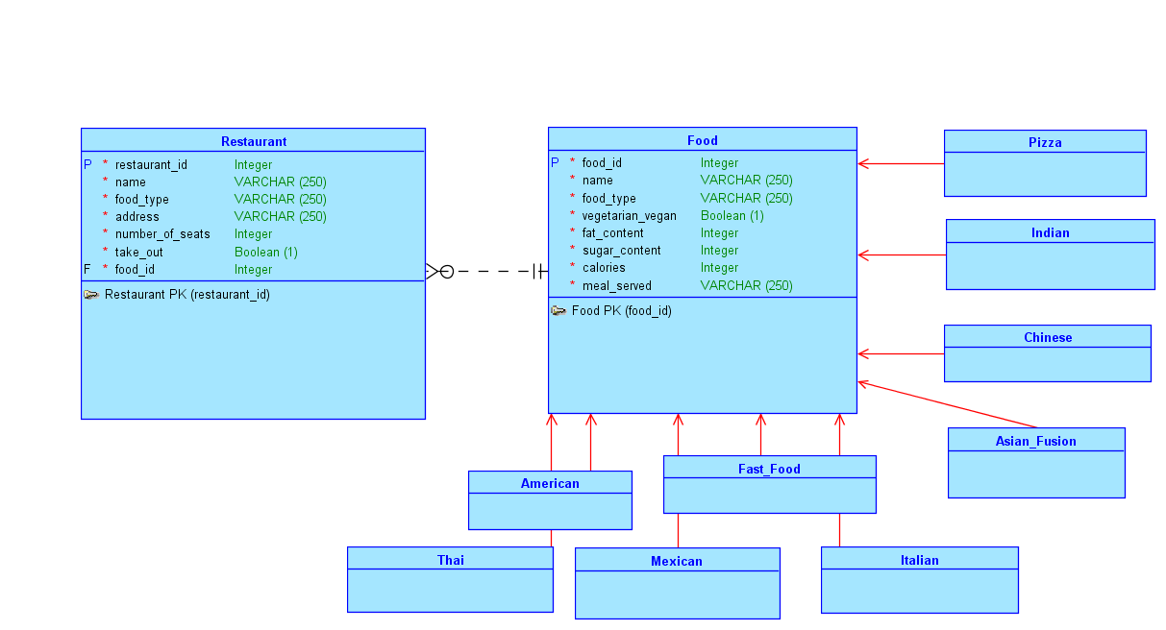

Slide 14
Part II: Restaurants Mobile App
Relates restaurants to the foods they serve
Our App allows users to find different restaurants in the area.
The app lists the restaurants as well as a link to each restaurant's website
Users can also get directions to each restaurant
Users can see each restaurant’s details as well as the nutrition facts of the types of foods served.

Slide 15
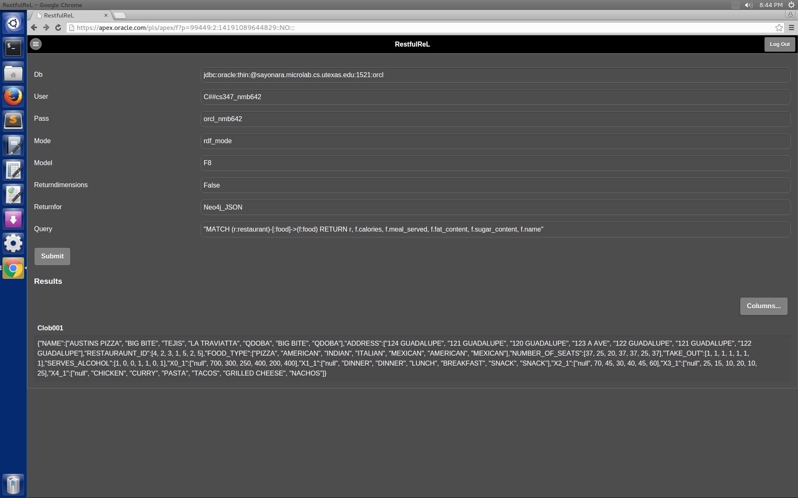
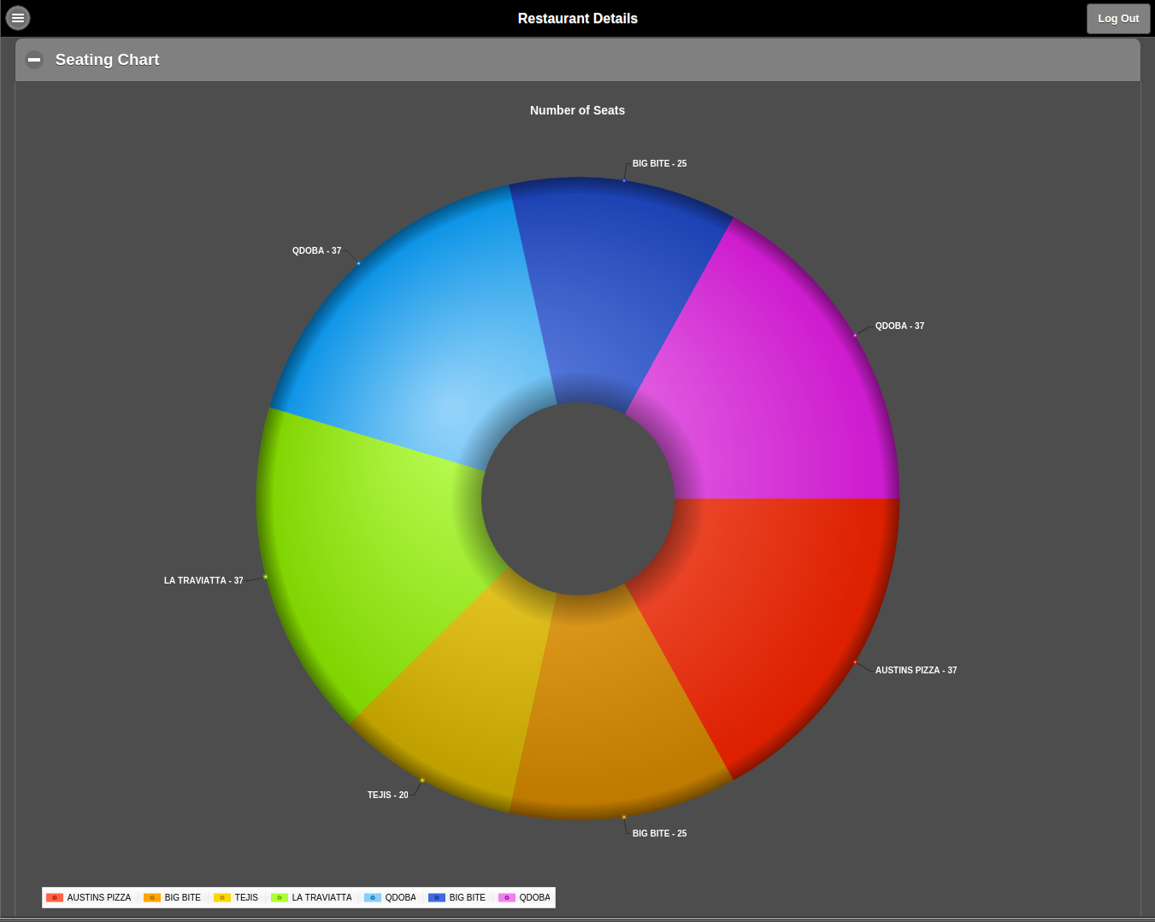

Slide 16
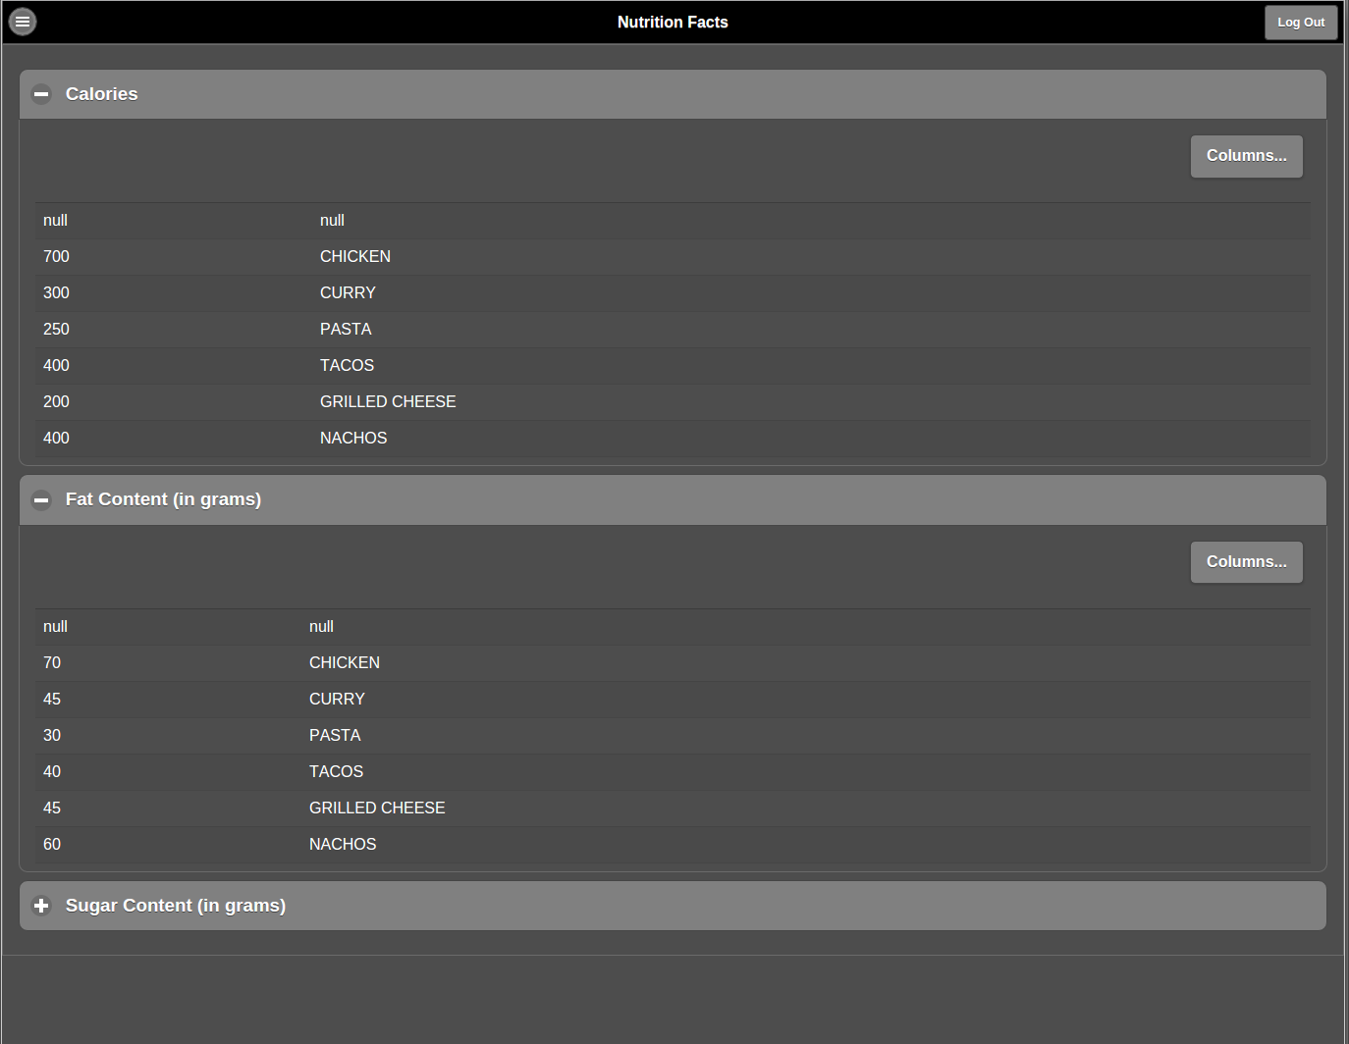
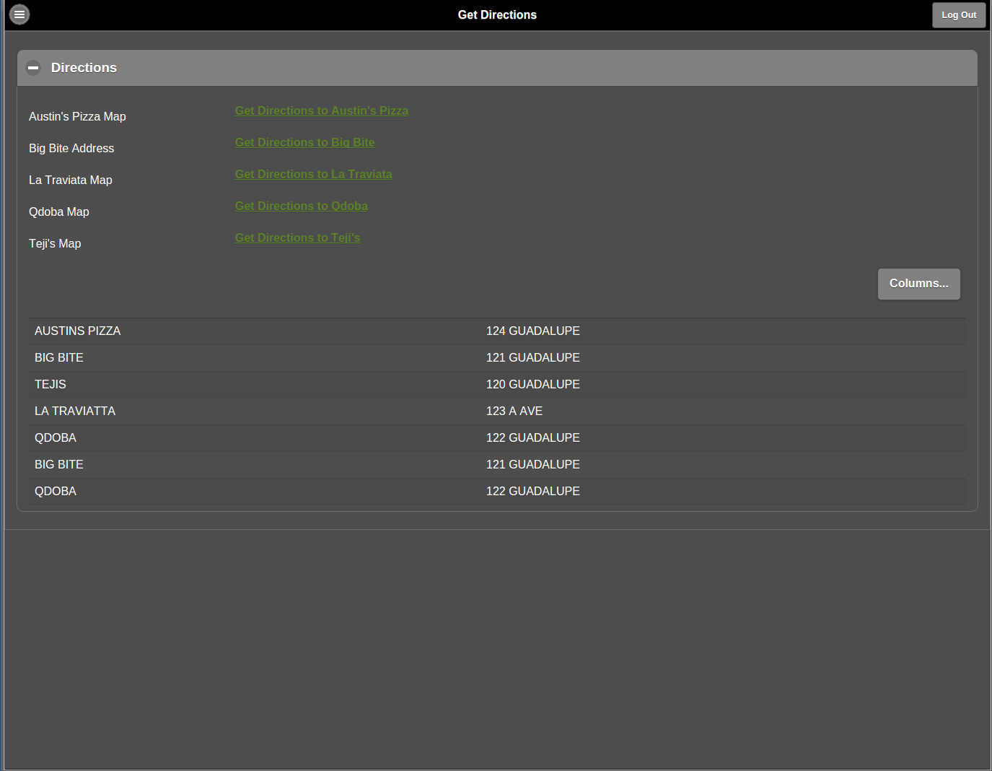

Slide 17
Restaurant Apex Model
https://apex.oracle.com/pls/apex/f?p=99449:1:14191089644829::NO:::

Slide 18
Github URL
https://github.com/sierra-acy/F15F8-final-project

